Slide 1
Project 5 IMDB Movie analysis from Abhishek Aware
Excel sheet Hyperlink-
https://docs.google.com/spreadsheets/d/1boUFIWLoBAwvILG2OiTlF3-_51fx87g-/edit?usp=sharing&ouid=106287796857122184484&rtpof=true&sd=true

Slide 2
Project Description
This project aims to provide insights into movie success using IMDB data. These insights can guide filmmakers and other stakeholders during movie production.
As data analysts, we received a dataset containing movie details, including IMDB scores and specific queries. Our goal is to analyze this data and answer these queries.
To achieve this, we will preprocess the data and use Microsoft Excel to extract, filter, and analyze information from the dataset, ultimately delivering the required insights.

Slide 3

Approach
We received a dataset from the IMDB database containing information on movies, including director names, actors, genres, plot keywords, budget, gross collection, and IMDB scores.
Our initial step was to familiarize ourselves with the dataset. Next, we performed data preprocessing, including handling duplicates.
After that, we filtered the data based on specific queries and created visualizations to enhance understanding. We then analyzed the filtered data and graphs to draw meaningful conclusions and insights.
With all necessary insights gathered, we will now prepare a detailed report to share with the hiring department.

Slide 4
Tech Stack Used
Microsoft Excel – A spreadsheet software commonly used by professionals for data entry, computations, and graph plotting. In this project, we used Excel to filter data, perform data cleaning, and create visualizations to gain insights into the movies.

Slide 5

Insights

Slide 6
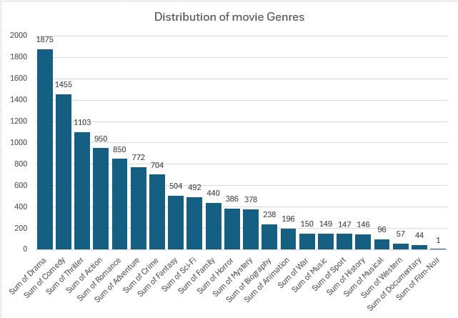
A. Movie Genre Analysis : Analyze the distribution of movie genres and their impact on the IMDB score. Task: Determine the most common genres of movies in the dataset. Then, for each genre, calculate descriptive statistics (mean, median, mode, range, variance, standard deviation) of the IMDB scores.
The top performing genres are drama,comedy,thriller,action,romance,adventure,crime

Slide 7
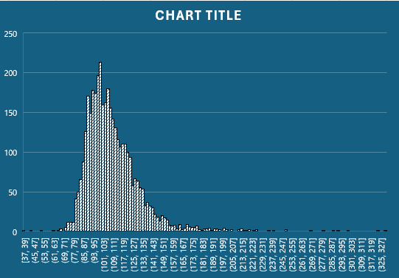
B. Movie Duration Analysis: Analyze the distribution of movie durations and its impact on the IMDB score. Task: Analyze the distribution of movie durations and identify the relationship between movie duration and IMDB score.
Most movies are of length 80-150 minute long
Movies with higher duration are very less in number

Slide 8
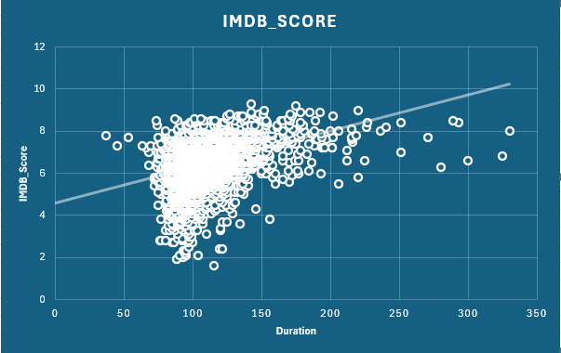
B. Movie Duration Analysis: Analyze the distribution of movie durations and its impact on the IMDB score. Task: Analyze the distribution of movie durations and identify the relationship between movie duration and IMDB score.
Movies with higher duration tends to haeve higher imdb score
Movies with 150+ min duration are likely to have 5+rating

Slide 9
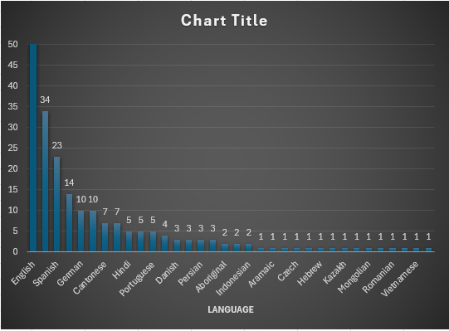
C. Language Analysis: Situation: Examine the distribution of movies based on their language. Task: Determine the most common languages used in movies and analyze their impact on the IMDB score using descriptive statistics
3564
top 5 languages are English,Spanish,german,cantonese,hindi
Most of movies are made in usa thus English is most used language in movies induastry

Slide 10
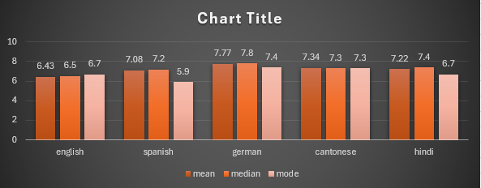
C. Language Analysis: Situation: Examine the distribution of movies based on their language. Task: Determine the most common languages used in movies and analyze their impact on the IMDB score using descriptive statistics
3564
Most movies are made in English
This chart shows us mean,median,mode of top 5 languages

Slide 11
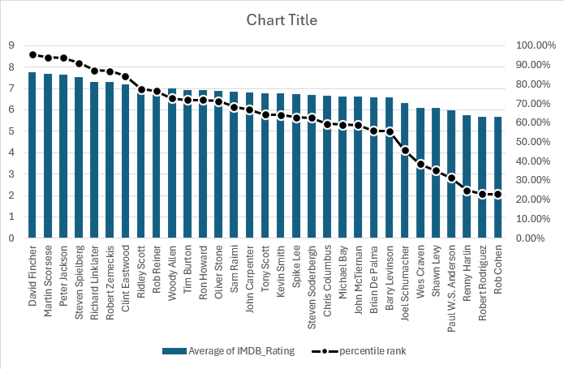
D. Director Analysis: Influence of directors on movie ratings. Task: Identify the top directors based on their average IMDB score and analyze their contribution to the success of movies using percentile calculations.
Director | Average of IMDB_Rating
David Fincher | 7.75
Martin Scorsese | 7.675
Peter Jackson | 7.654545455
Steven Spielberg | 7.544
Richard Linklater | 7.327272727
3564
Above are top 5 directors
We used directors who has made more than 9 movies for this visualisation
This visualisation shows us percentiles

Slide 12
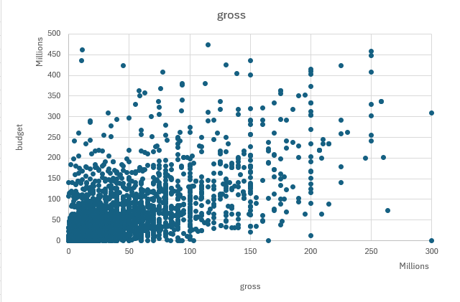
E. Budget Analysis: Explore the relationship between movie budgets and their financial success.Task: Analyze the correlation between movie budgets and gross earnings, and identify the movies with the highest profit margin.
3564
The plots above display the margins of movies in relation to their IMDB scores for the top directors. Each plot shows a positive trend line, indicating that as the margin increases, the IMDB score also tends to rise.

Slide 13
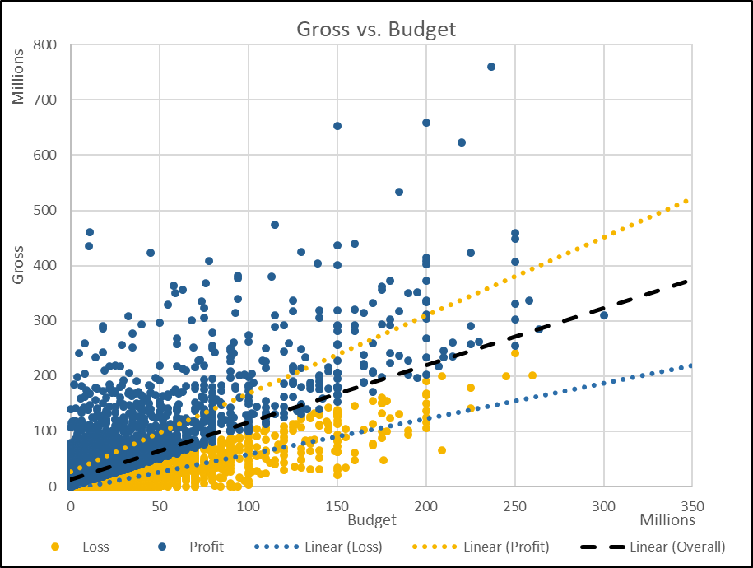
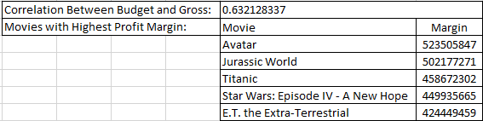
E. Budget Analysis: Explore the relationship between movie budgets and their financial success.Task: Analyze the correlation between movie budgets and gross earnings, and identify the movies with the highest profit margin.
3564
The table above indicates a positive correlation (greater than 0.5) between gross revenue and budget. This suggests that as a movie's budget increases, there is a high likelihood that its gross revenue will also increase.

Slide 14
Result
Project Insights:
Analyzed key factors in movie success, including:
Relationship between director and IMDb scores.
Influence of genres on ratings.
Correlation between budget and IMDb scores.
Data Analysis Skills Developed:
Addressed critical questions such as:
Relationship between budget and gross collections.
Impact of genres on movie ratings.
Technical Experience Gained:
Enhanced data preprocessing skills:
Data cleaning, handling outliers, and feature engineering.
Communication Skills:
Gained experience in effectively conveying insights to stakeholders to support data-driven decision-making.
Software Proficiency:
Improved understanding and usage of Microsoft Excel for data visualization, filtering, and analysis.

Slide 15
Thank you

